Slide 1



NEURAL NETWORKS
Course: Artificial Intelligence – Understanding opportunities and limitations across disciplines
10th January 2025,
Vignesh Mallya, Mohamed Elsafty

Slide 2
CONTENT
01
02
03
WHAT ARE NEURAL NETWORKS
BIOLOGICAL INSPIRATION
HOW NN WORKS
04
05
06
TYPES OF NN
ADVANTAGES
APPLICATIONS
07
08
ETHICAL IMPLICATIONS AND LIMITATIONS
CHALLENGES
Mohamed Elsafty: Topic 1, 2, 4, 7, 8
Vignesh Mallya : Topic 3, 4, 5, 6

Slide 3
WHAT ARE NEURAL NETWORKS?

Slide 4
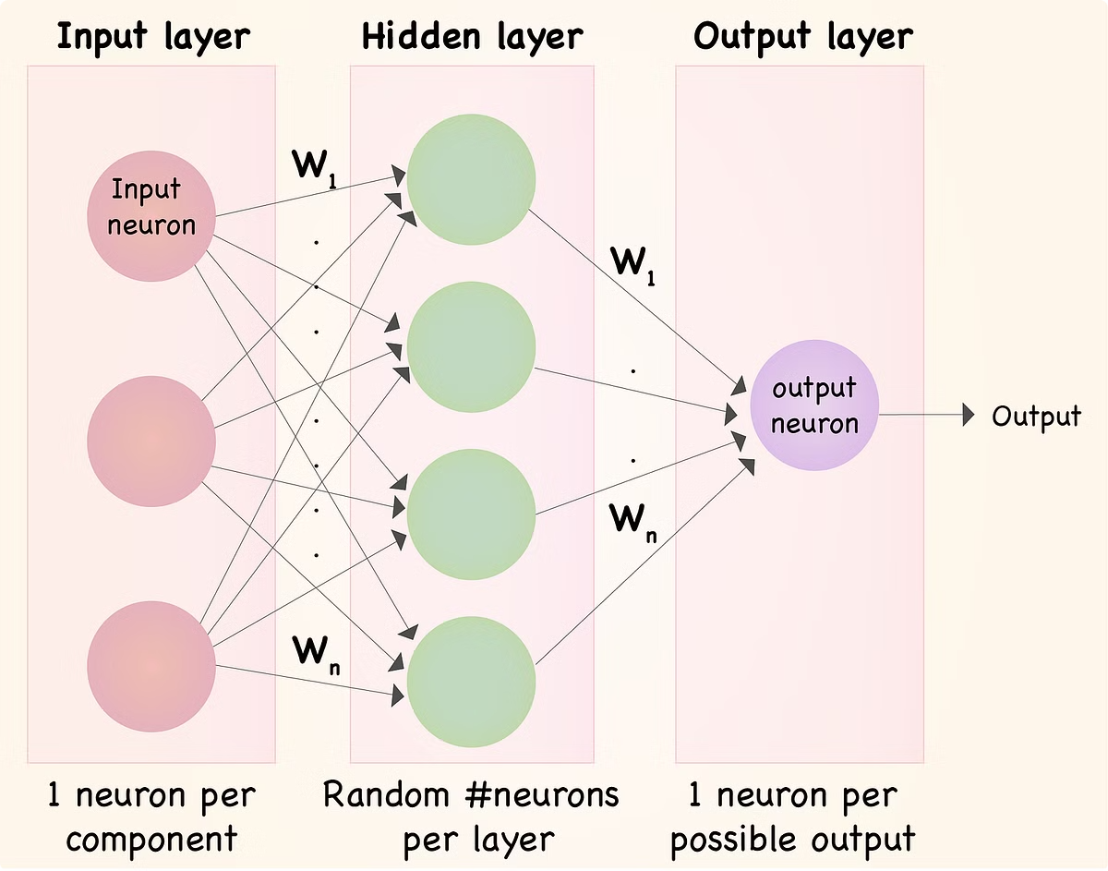
NEURAL NETWORKS
WHAT ARE NEURAL NETWORKS?
Algorithms that Learn
Connection Adjustment
Neural networks are algorithms designed to identify patterns within data.
The connections between neurons are dynamically adjusted based on the input data to optimize predictive capabilities.
Interconnected Neurons
Function Approximators
These algorithms are composed of interconnected 'neurons', organized into layers.
Essentially, they are sophisticated function approximators that learn through iterative examples.

Slide 5
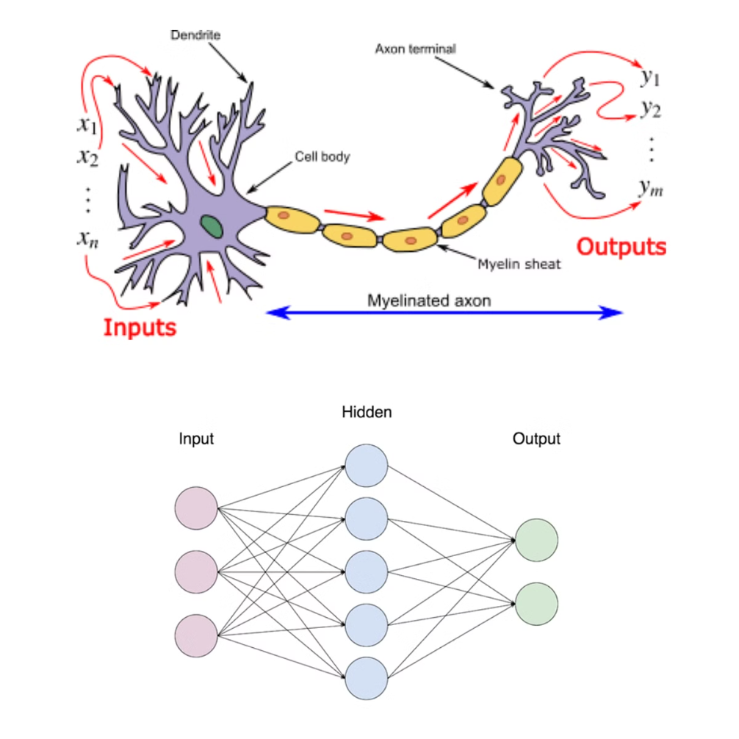
NEURAL NETWORKS
BIOLOGICAL INSPIRATION
Biological Neural Networks
1
Brains contain billions of interconnected neurons; the strength of these connections changes through learning.
Mimicking the Process
2
Artificial networks mimic this by adjusting weights during training.
Flexibility and Power
3
This brain-inspired architecture gives neural networks their flexibility and power.

Slide 6
HOW NEURAL NETWORKS WORK?

Slide 7
NEURAL NETWORKS
Hidden Layers
HOW NEURAL NETWORKS WORKS?
Input Layer
Output Layer

Slide 8
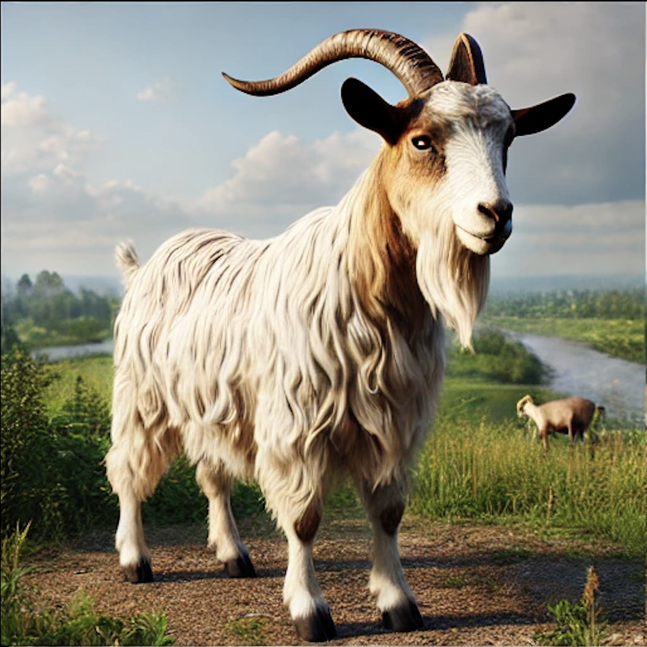
NEURAL NETWORKS
HOW NEURAL NETWORKS WORKS?
Forward Propagation
GOAT

Slide 9
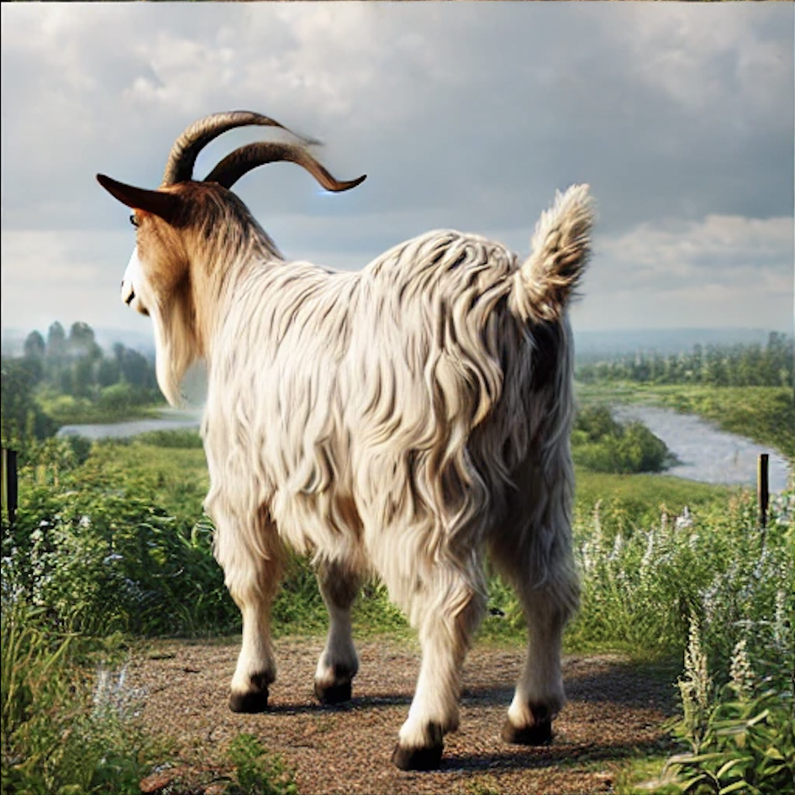
NEURAL NETWORKS
HOW NEURAL NETWORKS WORKS?
DOG
Backward Propagation

Slide 10
Weights
NEURAL NETWORKS
HOW NEURAL NETWORKS WORKS?
0.9
0.7
0.5
DOG
0.1
0.8
Backward Propagation

Slide 11
NEURAL NETWORKS
HOW NEURAL NETWORKS WORKS?
Output = Activation Function(∑(Input×Weight)+Bias)
0.9
0.7
0.5
GOAT
0.1
0.8

Slide 12
NEURAL NETWORKS
HOW NEURAL NETWORKS LEARNS?
HOW TO TRAIN NEURAL NETWORKS?
Supervised Learning
Training with labeled data to map inputs to desired outputs.
Unsupervised Learning
Training without labels, focusing on identifying patterns and clusters in data.
Reinforcement Learning
Learning through interaction with an environment using rewards and penalties to optimize strategies

Slide 13
TYPES OF NEURAL NETWORKS

Slide 14
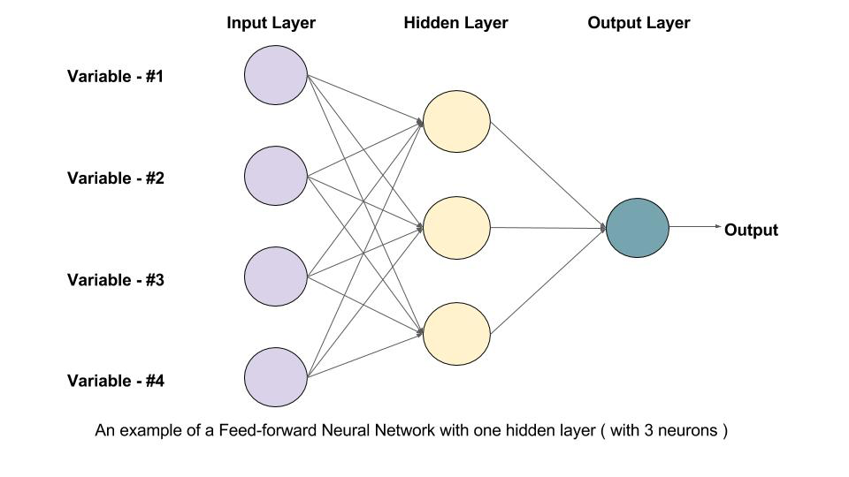
NEURAL NETWORKS
FEEDFORWARD NEURAL NETWORKS
FEEDFORWARD NEURAL NETWORKS (FNN)
The simplest type of NN where data flows in one direction: from input to output. Consists of an input layer, hidden layers, and an output layer. No loops or cycles.
Use Cases of FNNs
Classification:
Predicting class labels based on input features, commonly used for simple tasks where relationships are not too complex.
Regression:
Predicting continuous output values, useful in tasks where input features are related to a continuous target variable.
https://learnopencv.com/understanding-feedforward-neural-networks/
Advantages
Easy to implement. Suitable for simple pattern recognition tasks.

Slide 15
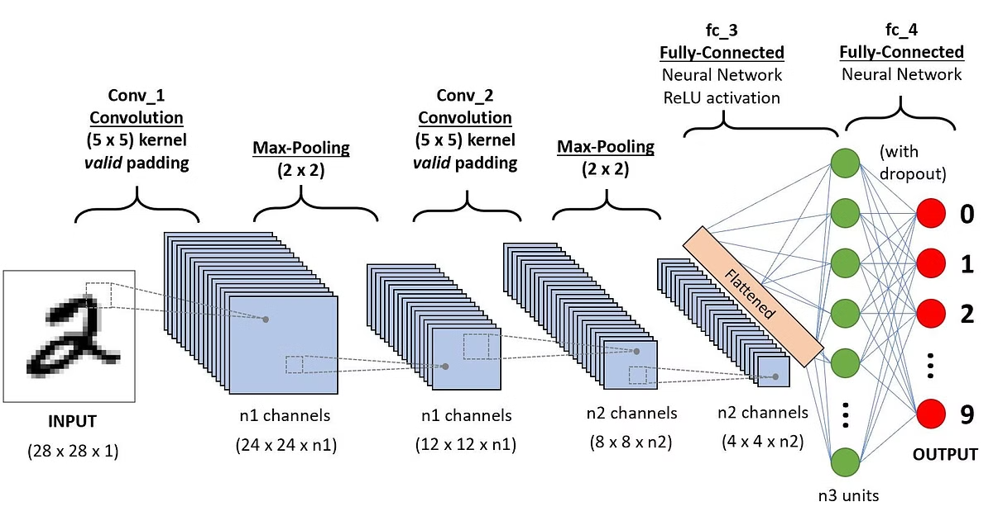
NEURAL NETWORKS
CONVOLUTIONAL NEURAL NETWORKS
CONVOLUTIONAL NEURAL NETWORKS (CNN)
Specialized NNs designed for processing grid-like data, such as images. Employ convolutional layers that detect spatial hierarchies and patterns like edges, shapes, and textures. Includes pooling layers for dimensionality reduction and feature extraction.
Use Cases of RNNs
Image Recognition:
Identifying objects, patterns, or features within images.
Object Detection:
Detecting and locating objects within images.
Video Analysis:
Analyzing video data by processing frames sequentially or in parallel to capture temporal relationships.
https://towardsdatascience.com/a-comprehensive-guide-to-convolutional-neural-networks-the-eli5-way-3bd2b1164a53
Advantages
High accuracy in image-related tasks. Efficient handling of large-scale data.

Slide 16
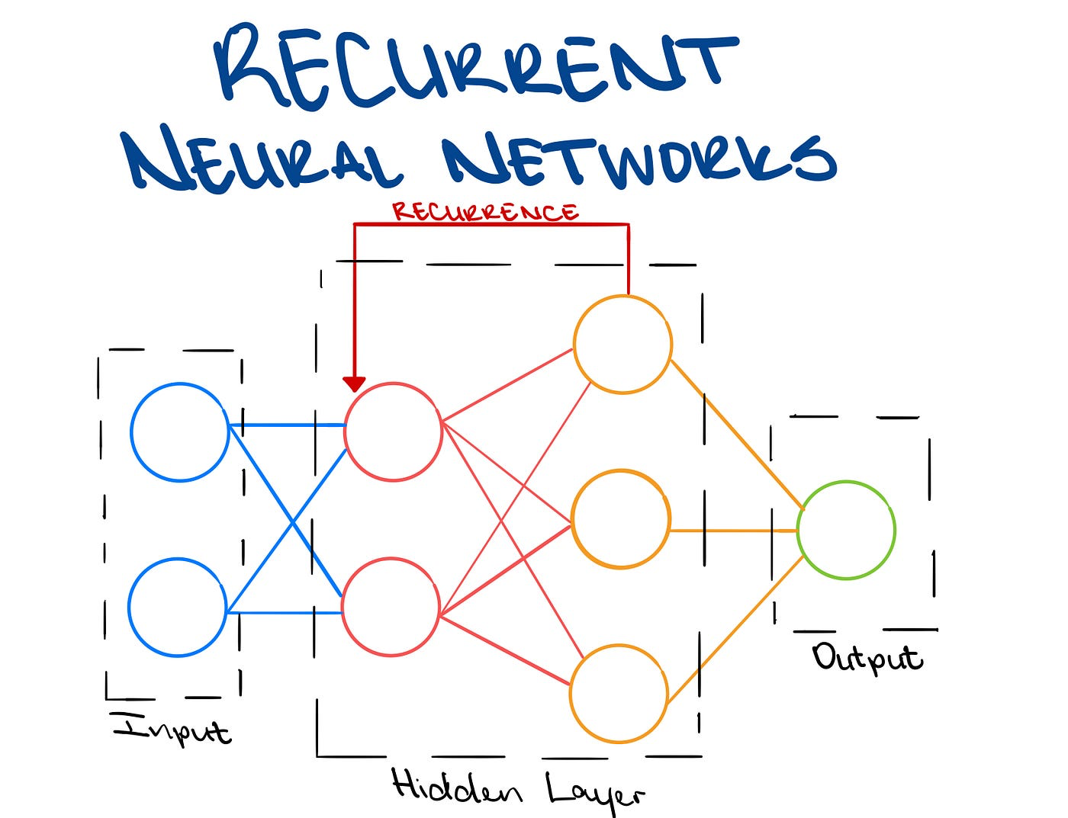
NEURAL NETWORKS
RECURRENT NEURAL NETWORKS
RECURRENT NEURAL NETWORKS
RNNs are particularly well-suited for processing sequential data, such as text or audio. They have internal memory to remember past inputs, allowing them to understand context and dependencies in data.
Use Cases of RNNs
Natural Language Processing (NLP):
Language modeling, Text generation, Machine translation
Speech Recognition:
Processing audio data for recognizing speech patterns
Time Series Prediction:
Modeling temporal dependencies for forecasting
Advantages
RNNs excel at capturing long-term dependencies, making them powerful tools for understanding complex sequential data.
https://towardsdatascience.com/introducing-recurrent-neural-networks-f359653d7020

Slide 17
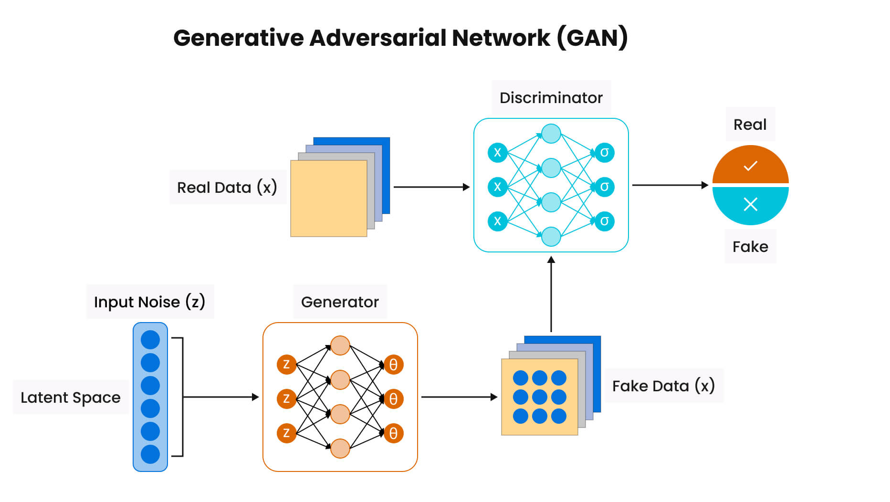
NEURAL NETWORKS
GENERATIVE ADVERSARIAL NETWORKS
GENERATIVE ADVERSARIAL NETWORKS
GANs are a type of generative model that learns to create new data samples that resemble the training data.
Generator: Creates fake data.
Discriminator: Tries to distinguish between real and fake data.
Use Cases of GANs
Image Generation:
Creating realistic, high-resolution photos.
Data Augmentation:
Generating synthetic data to augment training datasets.
Creative Applications:
Generating artwork or music.
https://www.solulab.com/generative-adversarial-network/
Advantages
GANs are known for their ability to generate high-quality, realistic data samples, surpassing traditional generative methods.

Slide 18
NEURAL NETWORKS
TYPES OF NEURAL NETWORK
DIFFUSION MODELS
FEEDFORWARD NEURAL
NETWORKS
GENERATIVE ADVERSARIAL
NETWORKS
CONDITIONAL GAN (CCAN)
DEEP CONVOLUTIONAL GAN (DCCAN)
CYCLE CAN
STYLE GAN
CONVOLUTIONAL
NEURAL NETWORKS
?
TRANSFORMERS
RECURRENT NEURAL
NETWORKS
VARIATIONAL AUTOENCODERS
AUTOENCODERS
LSTM AND GRU

Slide 19
ADVANTAGES & APPLICATIONS

Slide 20
NEURAL NETWORKS
ADVANTAGES
Adaptability: Learns complex or undefined relationships between inputs and outputs.
Pattern Recognition: Excels in tasks like audio/image recognition and natural language processing.
Parallel Processing: Processes multiple tasks simultaneously for faster computations.
Non-Linearity: Models complex relationships using non-linear activation functions.

Slide 21






NEURAL NETWORKS
APPLICATIONS
COMPUTER VISION
SPEECH RECOGNITION
Neural networks analyze images and videos to detect objects, recognize faces, and enable advanced visual tasks.
They convert spoken language into text, enabling voice assistants and real-time transcription.
NATURAL LANGUAGE PROCESSING
RECOMMENDATION ENGINES
Neural networks process and understand human language for translation, search, and conversational AI.
They predict user preferences to provide personalized suggestions for content or products.

Slide 22
ETHICAL IMPLICATION, LIMITATIONS & CHALLENGES

Slide 23



NEURAL NETWORKS
IMPLICATIONS AND LIMITATIONS
ETHICAL IMPLICATIONS AND LIMITATIONS
Autonomy and Individuality
Responsibility Gaps
Societal Implications
Neural networks are increasingly used in AI systems that make decisions impacting hiring, lending, and healthcare. Over-reliance on these automated systems risks diminishing human autonomy in decision-making.
Determining accountability for decisions made by neural networks remains challenging. This is particularly apparent in cases like autonomous vehicle accidents where responsibility is unclear.
Widespread AI adoption has the potential to significantly disrupt various aspects of society, including job markets, privacy, and socio-economic structures. Automation, for instance, may lead to widespread unemployment.

Slide 24

NEURAL NETWORKS
CHALLENGES
BLACK-BOX NATURE AND CHALLENGES
Black-Box Nature
NNs are often criticized for their opacity—difficult to interpret or explain how they arrive at decisions. This "black-box" nature undermines trust, especially in high-stakes domains like healthcare and law enforcement.
Computational Costs
Training deep NNs requires vast computational resources, leading to high energy consumption and carbon footprint. Example: Training GPT-3 required 1,287 MWh of electricity and emitted 552 metric tons of CO₂.
Bias in Training Data
If training data is biased, NNs perpetuate and even amplify those biases. Example: Facial recognition systems often perform poorly on minority groups due to underrepresentation in training datasets.

Slide 25
THANK YOU!

Slide 26
NEURAL NETWORKS
REFERENCES
Goodfellow, I., Bengio, Y., & Courville, A. (2016). _Deep Learning_. MIT Press
LeCun, Y., Bengio, Y., & Hinton, G. (2015). "Deep learning." _Nature_, 521(7553), 436-444.
Domingos, P. (2015). _The Master Algorithm: How the Quest for the Ultimate Learning Machine Will Remake Our World_. Basic Books.
Strubell, E., Ganesh, A., & McCallum, A. (2019). "Energy and policy considerations for deep learning in NLP." _arXiv preprint arXiv:1906.02243_.
O’Neil, C. (2016). _Weapons of Math Destruction: How Big Data Increases Inequality and Threatens Democracy_. Crown Publishing Group.
Aston Zhang, Zachary C. Lipton, Mu Li, & Alexander J. Smola. (2023). Dive into deep learning. D2L.ai. https://d2l.ai/index.html
Amazon Web Services. (n.d.). What is a neural network? https://aws.amazon.com/what-is/neural-network/
GeeksforGeeks. (2024). Neural networks: A beginner's guide. https://www.geeksforgeeks.org/neural-networks-a-beginners-guide/
Coursera. (2024, April 10). Neural network examples, applications, and use cases. https://www.coursera.org/articles/neural-network-example

